Slide 1


PHONEPE TRANSACTION INSIGHTS
Data Science Mini Project By Vijay Karthik S.K

Slide 2
PROBLEM
Understand how people use PhonePe in different states. Find patterns: which payments grow faster and when.

Slide 3


GOALS
Check transaction trends across states and districts. See how many people join and use the app.
Study growth of PhonePe insurance. Show top regions with easy visuals.

Slide 4
TOOLS
Python → For working with data. MySQL → To store and organize data. Streamlit → To make dashboards.

Slide 5

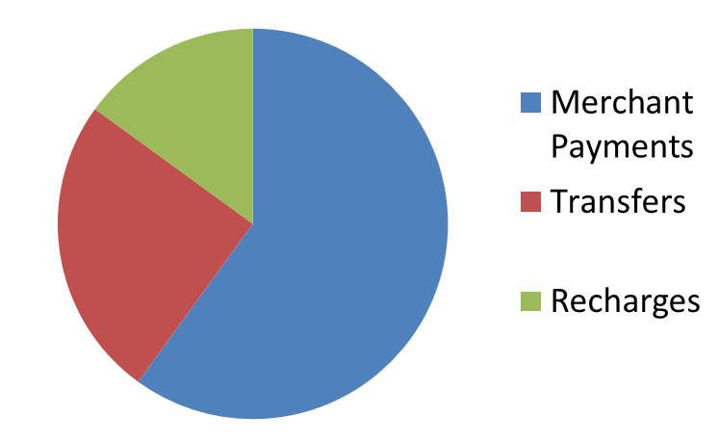
TRANSACTIONS
Most people use PhonePe for merchant payments. Some use it for transfers and recharges.
Big states show fast growth.

Slide 6



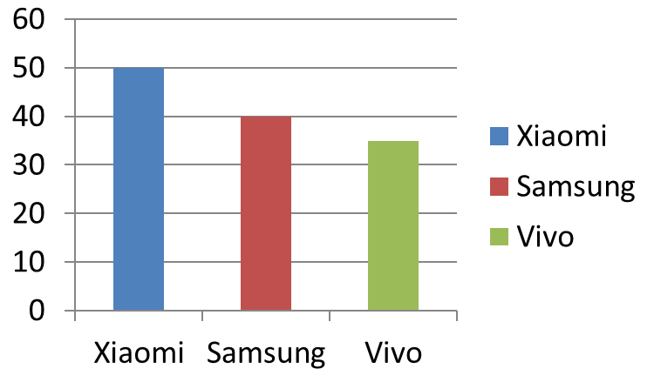

PHONES AND USERS
Xiaomi, Samsung, and Vivo have most users. People open the app many times a day.
Bengaluru and Pune lead in usage.

Slide 7

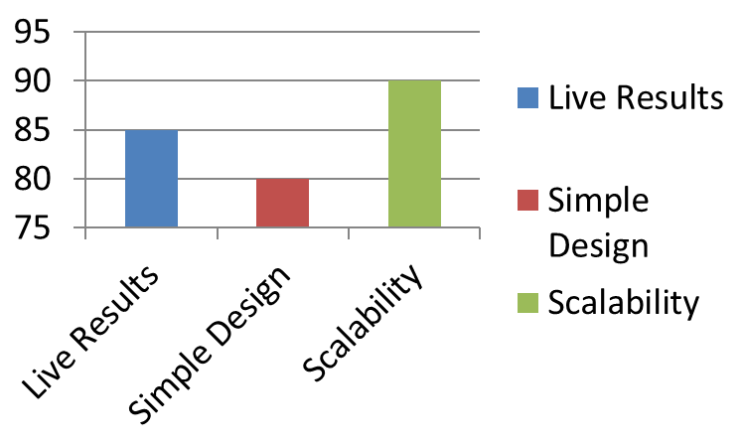

CONCLUSION
Dashboards show results live. Design is simple and useful.
Can easily add more features later.

